Slide 1
EXERCISE 1.8 - BOOLEAN FUNCTIONS
Goia Alexia Maria

Slide 2
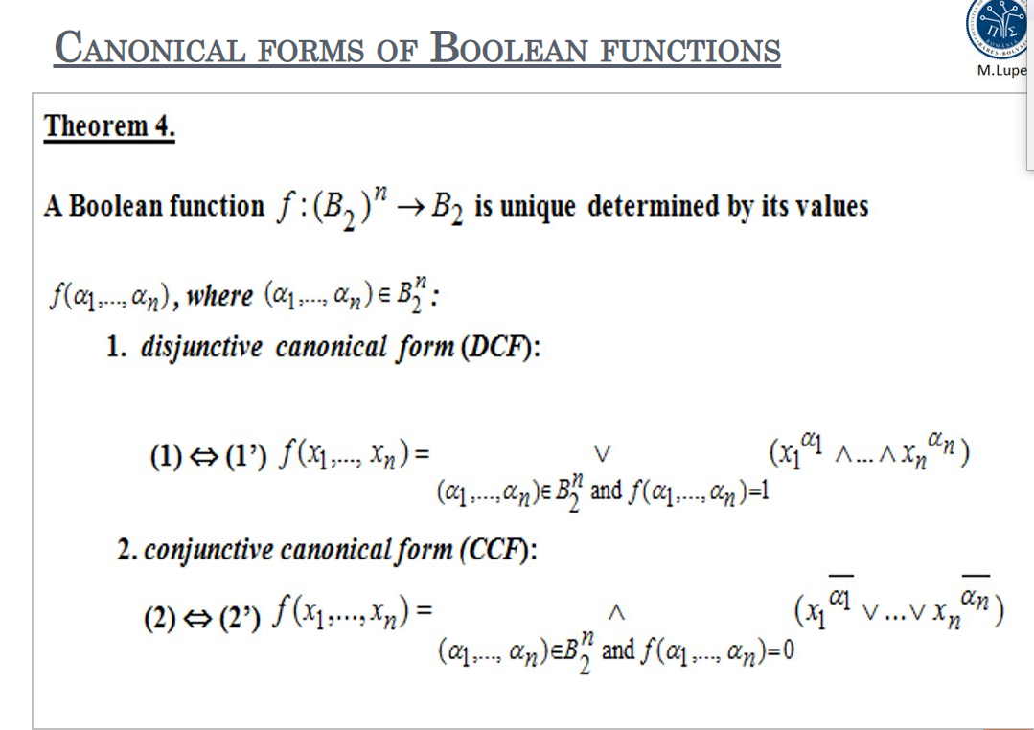
Theory

Slide 3
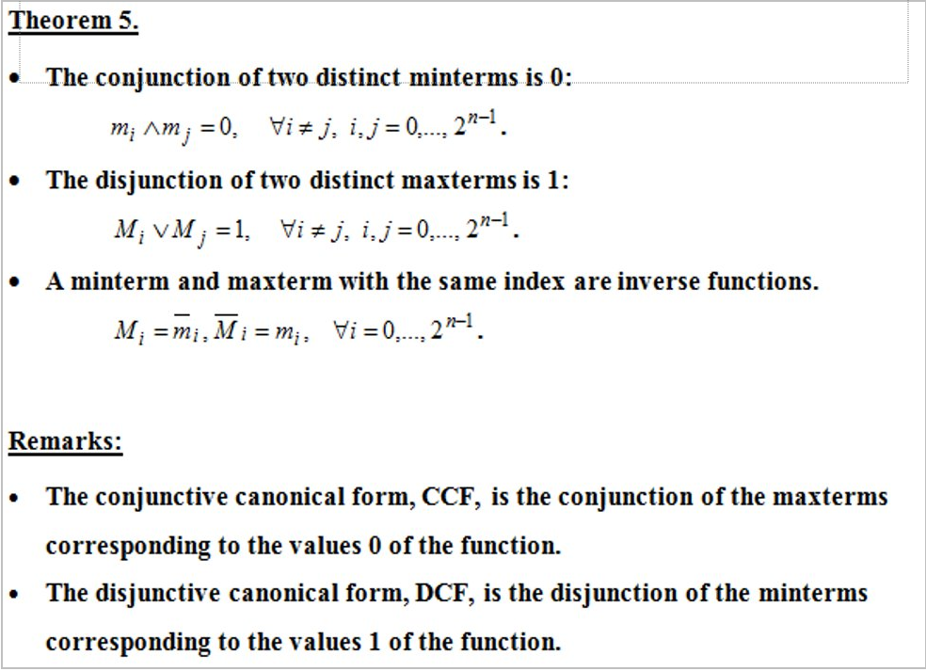

Slide 4
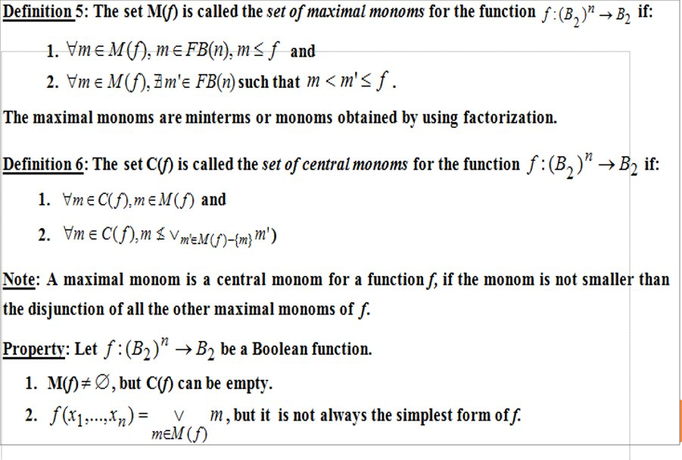

Slide 5
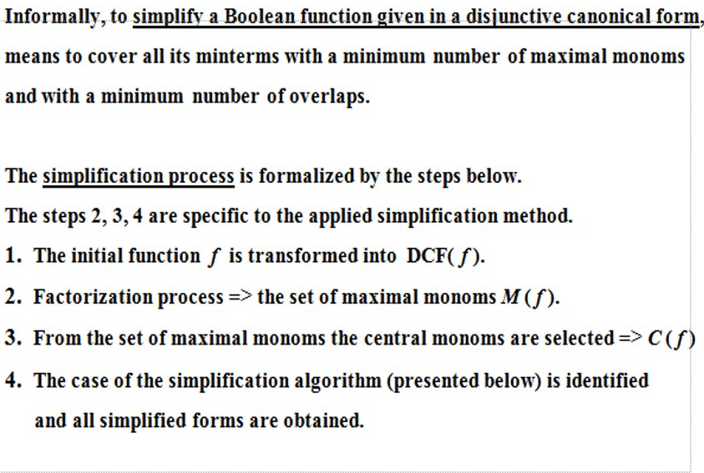

Slide 6
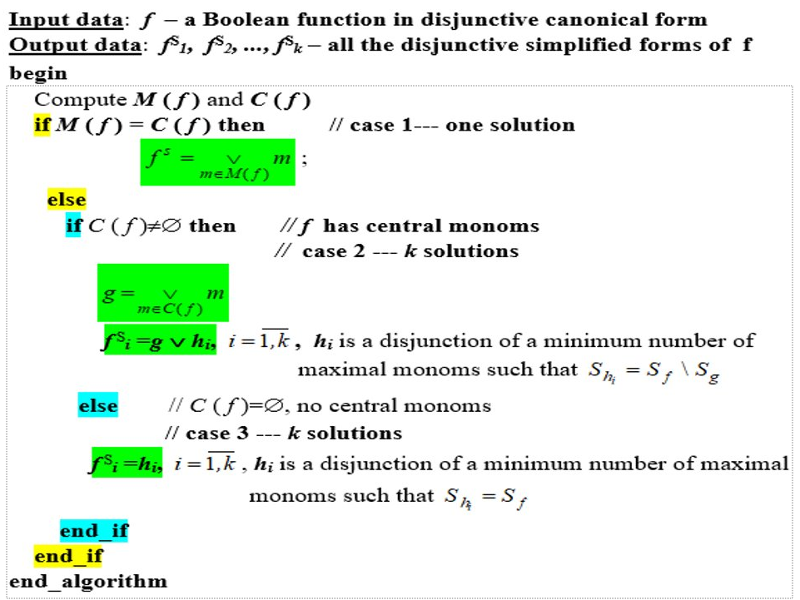

Slide 7
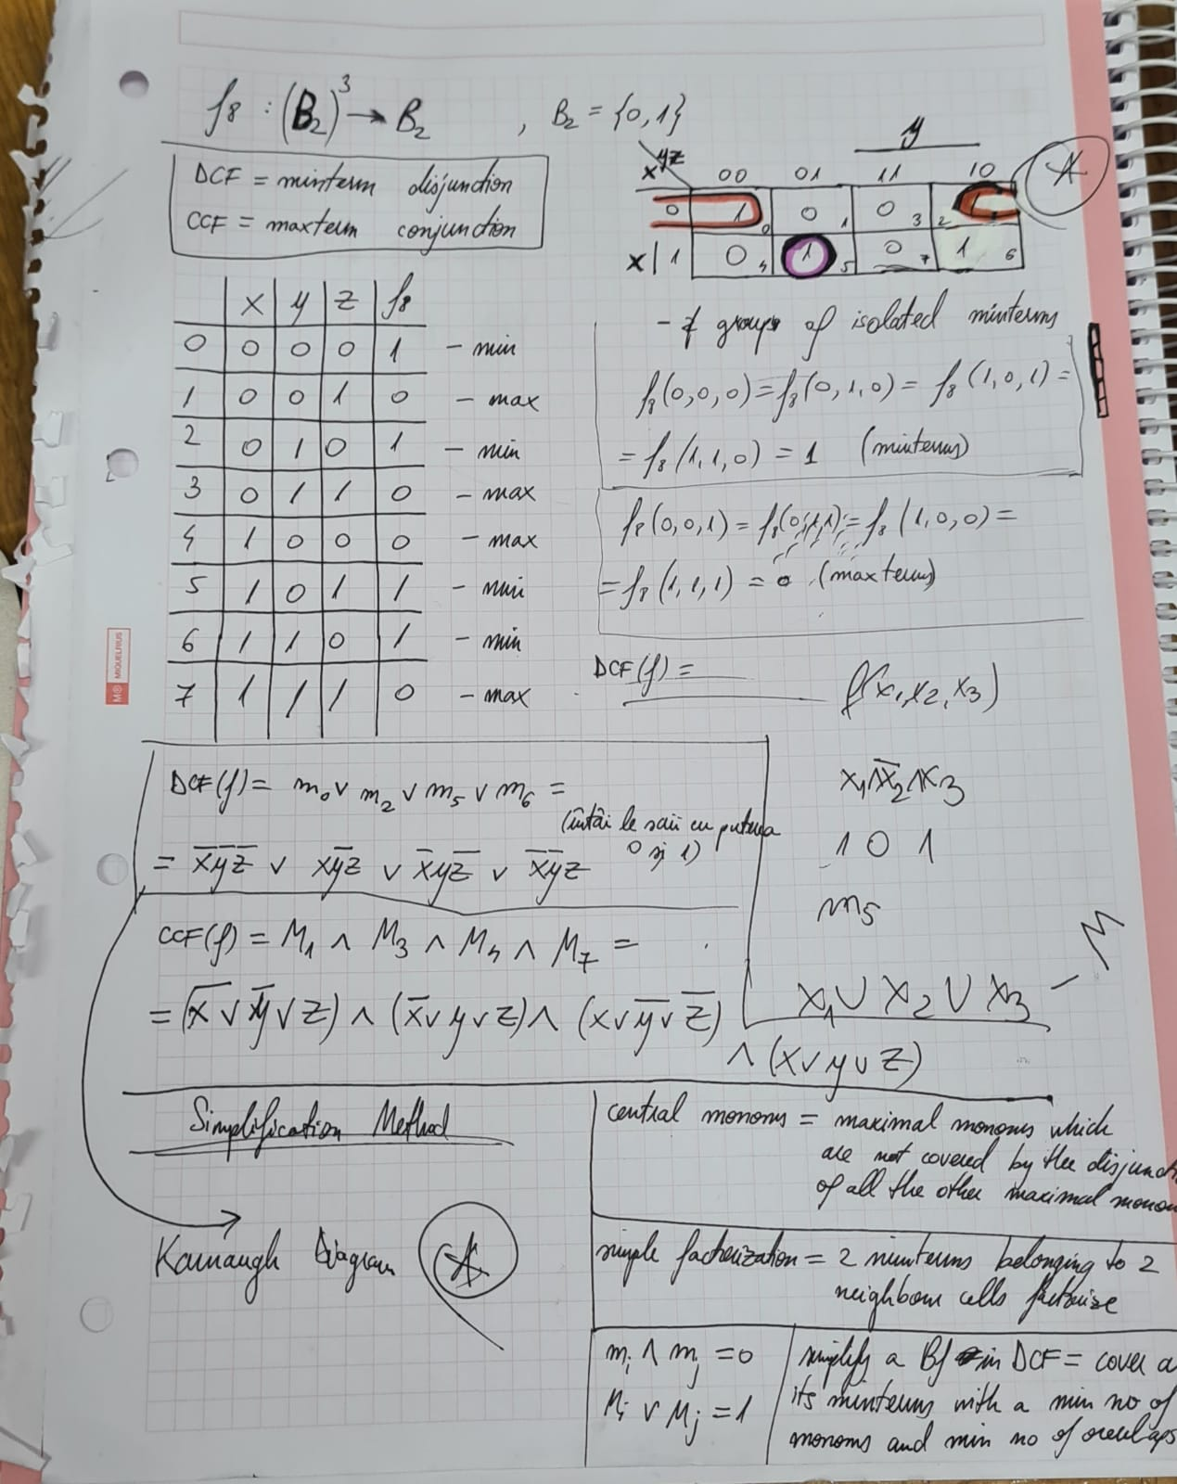

Slide 8
Thank you for the attention! ;)

Slide 9
